Slide 1

BYTEBATTLE
Hackathon 2025
REPORTIFY
BY THE 3AM CODERS
“Because reporting a problem shouldn’t be a problem.”

Slide 2

THE PROBLEM
IMPACT:
  Slower fixes
  Lower quality of life
  Wasted time + resources
  Unsafe living conditions in some areas
IN MOST COMMUNITIES:
  Problems like garbage overflow, broken streetlights, unsafe areas, water issues, harassment, etc. go unreported.
  Many people don’t know whom to contact, or the process is slow and complicated.
  RWAs, municipalities, and local officials get information late, so issues pile up.

Slide 3
WHY IT MATTERS
COMMUNITIES THAT DON’T TRACK ISSUES IN REAL-TIME STRUGGLE WITH:
  Poor maintenance
  Delayed responses
  Reduced public trust
  Higher repair costs later
BUT — WITH FAST REPORTING, 60–80% OF LOCAL ISSUES CAN BE SOLVED EARLY.

Slide 4
OUR AI SOLUTION
SOCIAL EYE AUTOMATICALLY:
  COLLECTS SOCIAL ISSUES USERS SUBMIT (TEXT, PHOTO, VOICE).
  Identifies the category (waste, safety, water, electricity, roads, etc.).
  Extracts the exact problem using NLP + image recognition.
  Sends the report instantly to the right RWA/official/department.
NO FORMS. NO DELAYS. JUST SMART REPORTING.

Slide 5
HOW IT WORKS (SIMPLE FLOW)
1 — USER REPORTS
A resident sends a text, photo, or voice note about a problem.
2 — AI Detects the Issue
Our model identifies the category (waste, road, safety, water, etc.) and rates severity.
3 — Auto-Routing
The system instantly sends the issue to the correct RWA or government department.
4 — Dashboard View
Officials see all reports with: issue type, image, priority, and time received.
5 — Status Tracking
Users get updates as the issue moves from Pending → In Progress → Resolved.

Slide 6
SOCIAL IMPACT
1.CLEANER, SAFER COMMUNITIES
AI-driven reporting makes it easier to fix daily issues like waste, road damage, and lighting problems, improving overall living conditions.
2.Faster Response Times
Authorities receive issues instantly, reducing delays and helping fix problems before they grow bigger.3..Better Accountability
Every report is tracked. Officials can’t ignore or lose complaints — everything is visible on the dashboard.
4.Data-Driven Decisions
Patterns show which areas face the most problems, helping RWAs and municipalities plan budgets, manpower, and repairs more effectively.
5.Community Engagement
Residents feel heard and are more likely to report issues because it’s quick and simple.
6.Reduced Workload for Officials
Instead of manually collecting complaints, the AI organizes, categorizes, and prioritizes them.

Slide 7
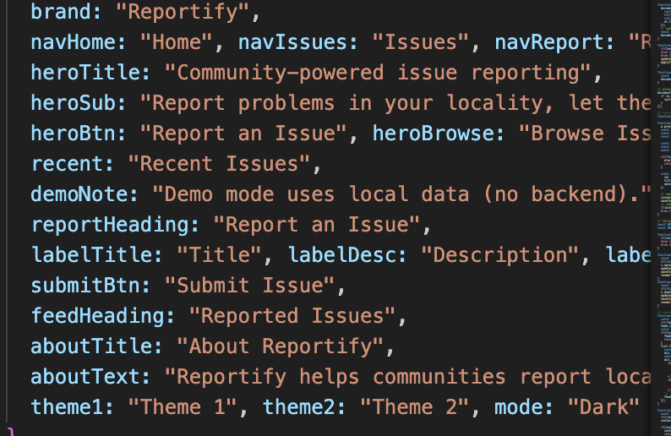
Demo / Prototype

Slide 8
METRICS / EXPECTED RESULTS
WE HOPE TO MAKE AN IMPACT BY PROVIDING THE CITIZENS WHAT THEY WANT.
Our AI reduces reporting delays dramatically and ensures issues reach the right officials instantly. This leads to fewer missed complaints, faster responses, and clearer tracking for residents. Overall, it makes community problem-solving quicker, more organized, and more reliable.

Slide 9
TECH STACK
NLP MODEL -GEMINI API
BACKEND-JAVASCRIPT,HTML AND CSS
TEXT EDITOR-V S CODE

Slide 10

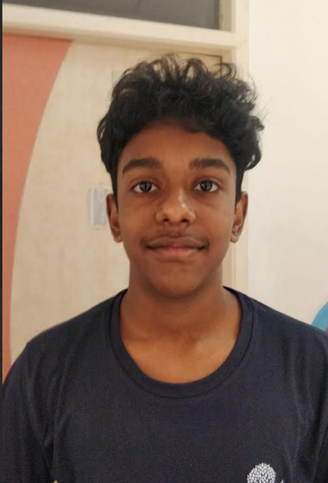

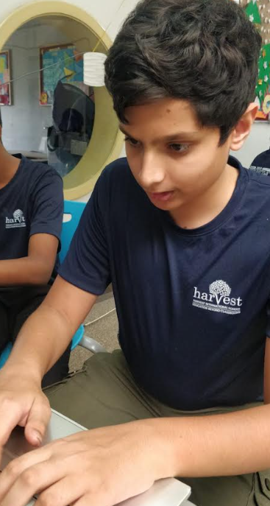

THANK YOU.

